Slide 1

IBM i Unit Testing Now in VS Code!
Sanjula Ganepola
Software Developer – IBM i App Dev & AI Toolchain
Sanjula.Ganepola@ibm.com
2025 February

Slide 2










What is missing in the VS Code stack?
Other
Db2 for IBM i
IBM i Renderer
Vendor Extensions
Code for IBM i
Source Orbit
IBM i Project Explorer
IBM i Languages
IBM i Debug
CL
Other Tooling
Code Coverage
RPGLE
Code Coverage
Language Extensions
Archived

Slide 3
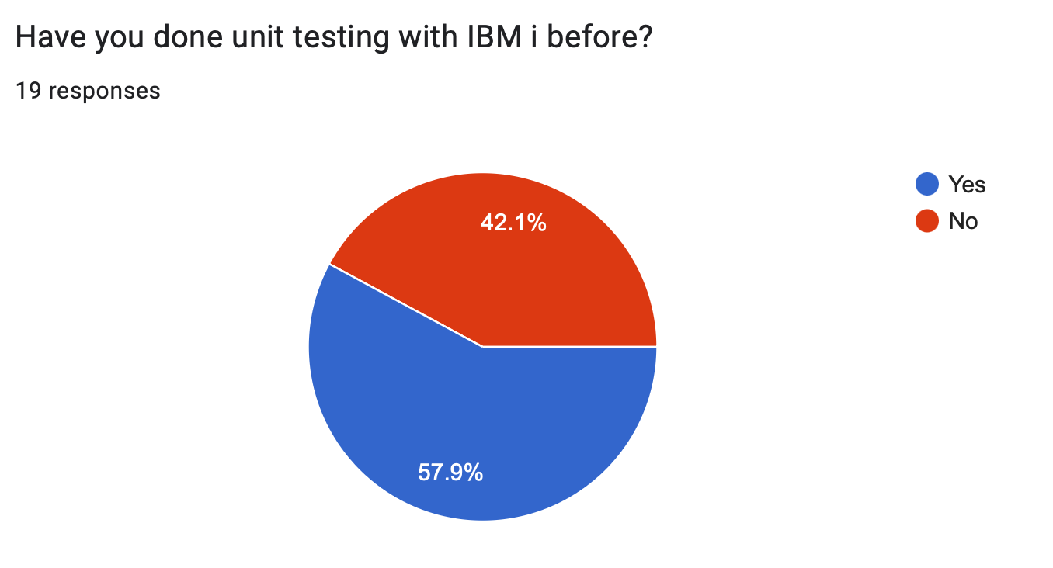
We did a survey…

Slide 4
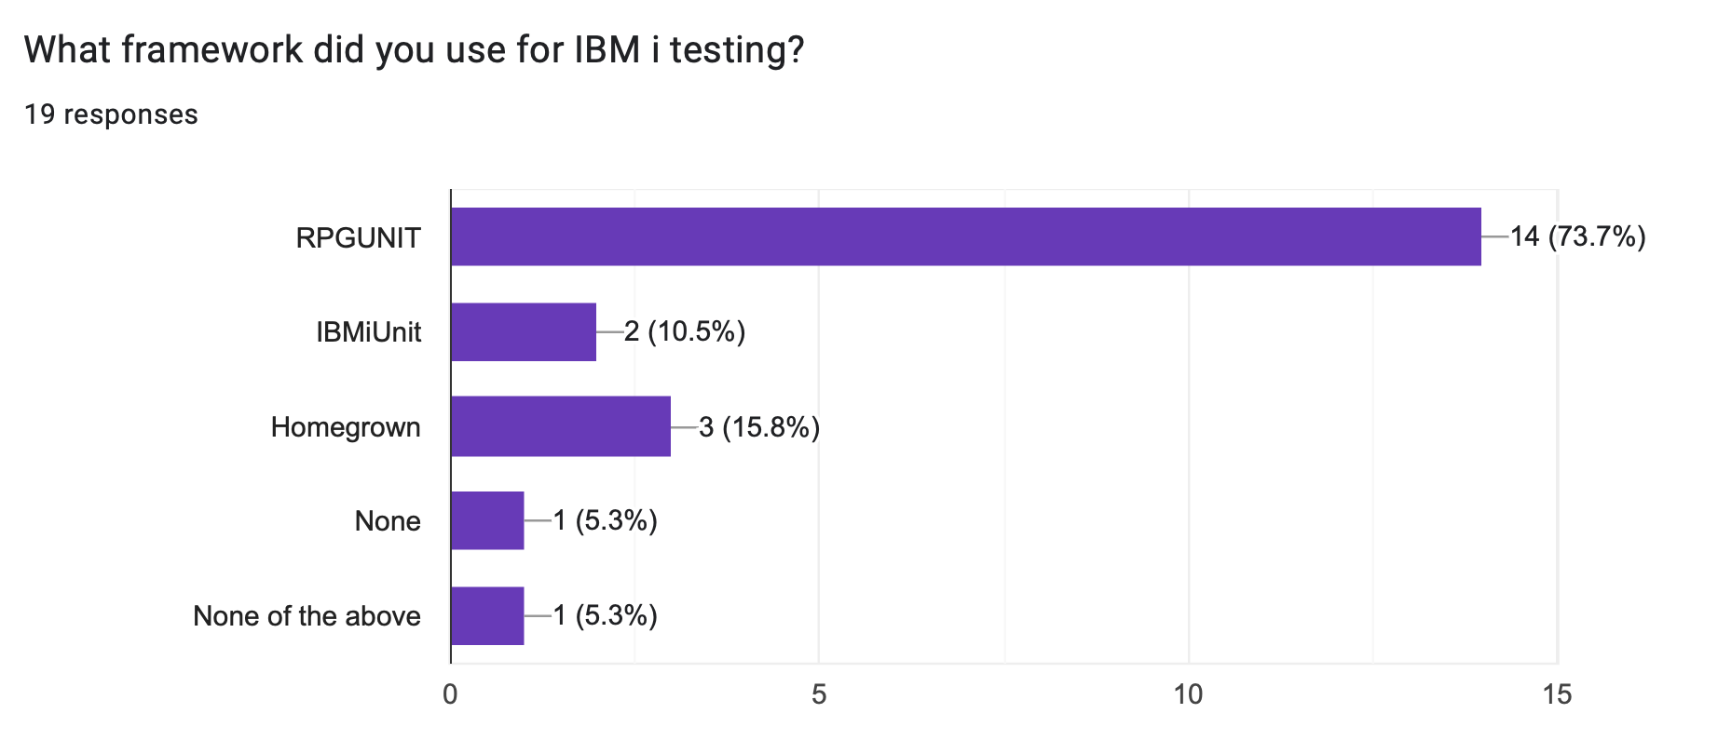
We did a survey…

Slide 5
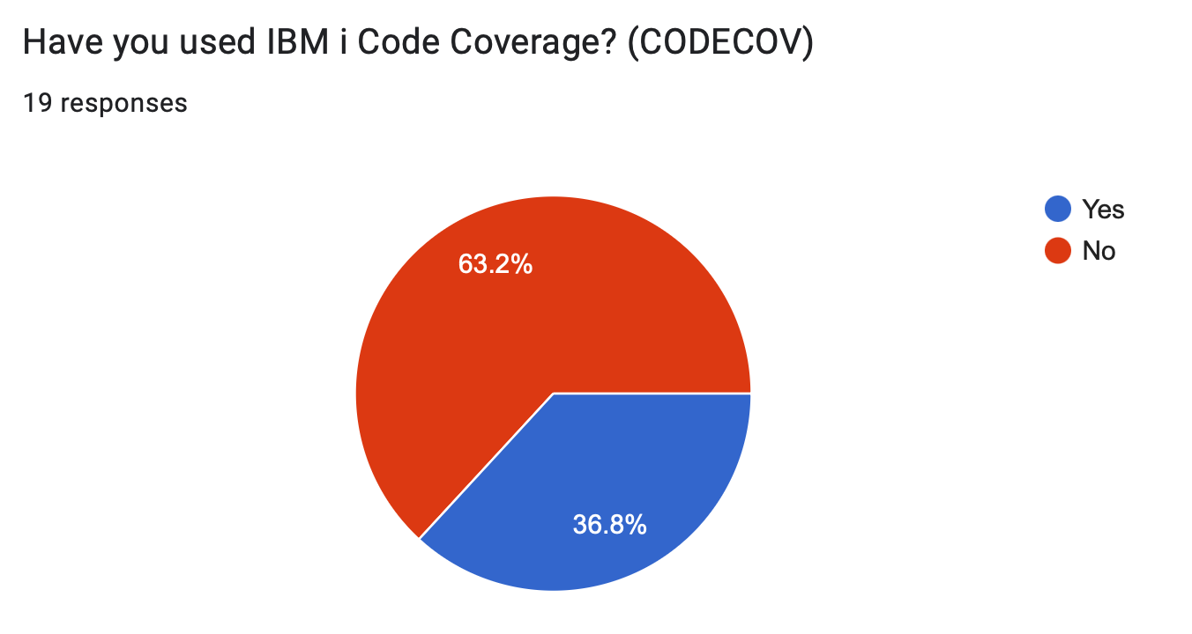
We did a survey…

Slide 6
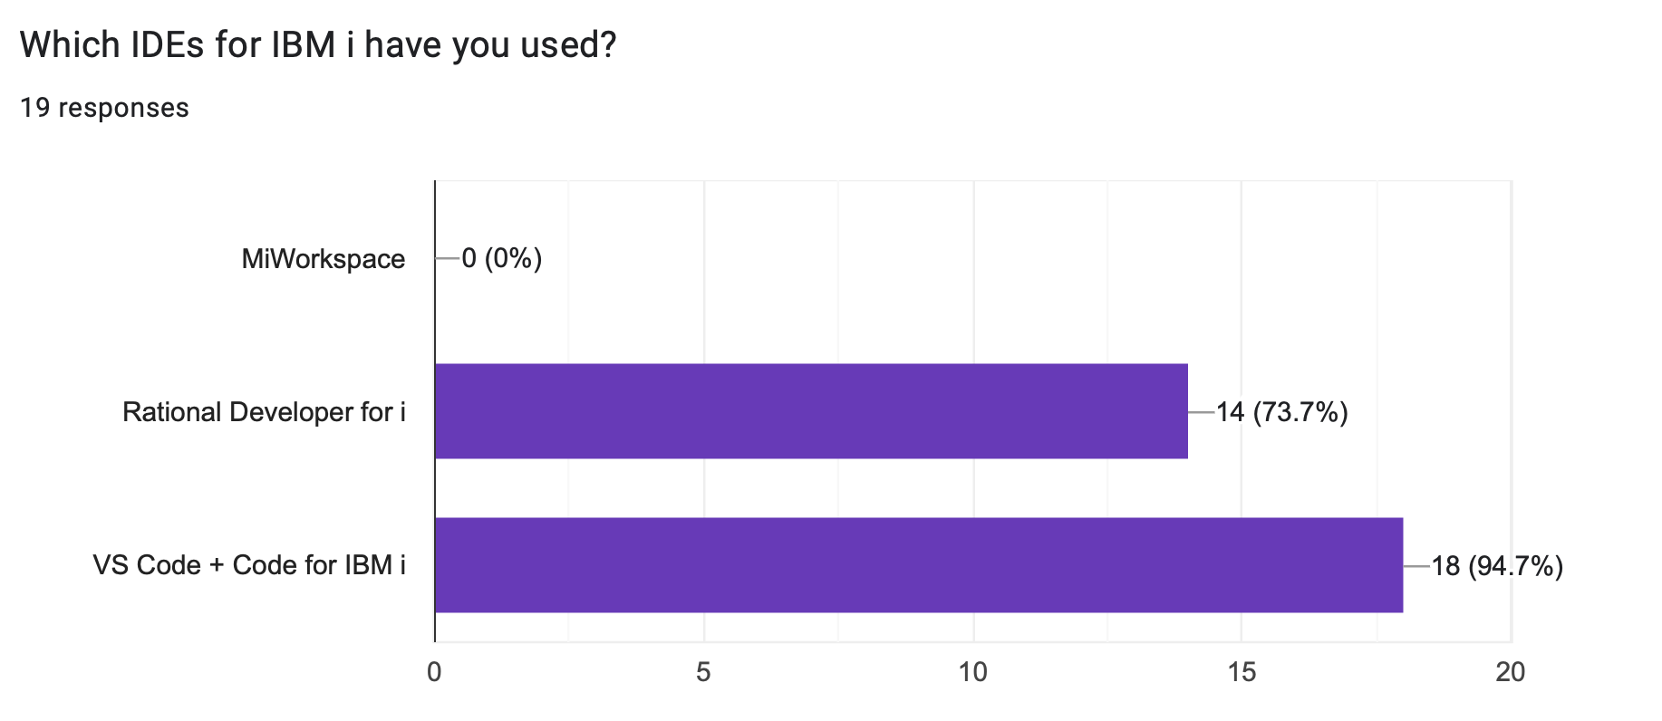
We did a survey…

Slide 7

Let’s look at the new IBM i Testing Extension

Slide 8
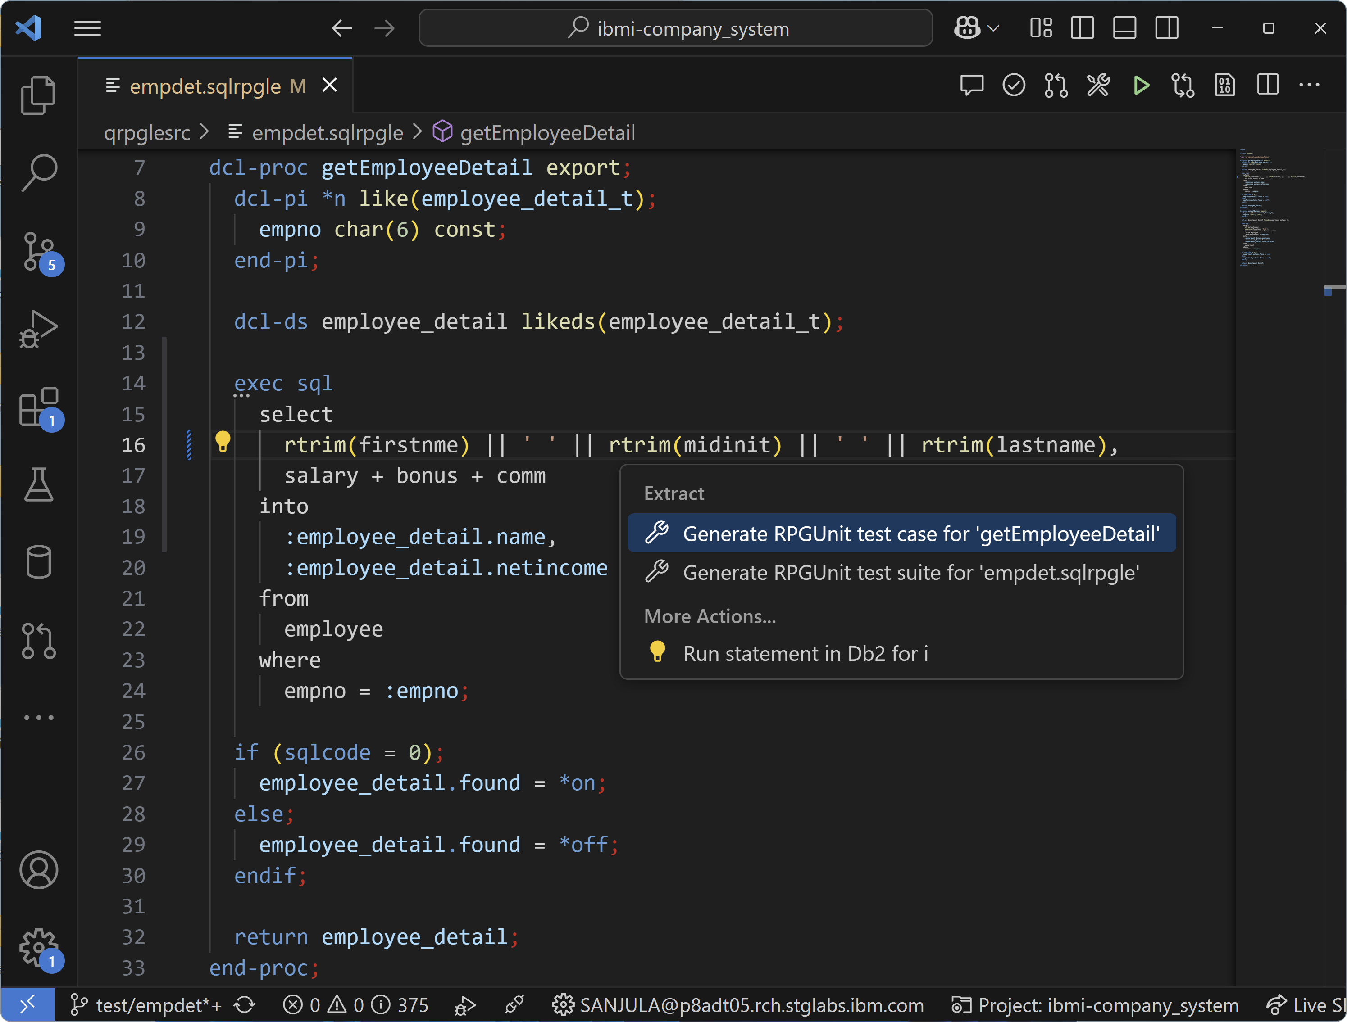
Generating test stubs

Slide 9
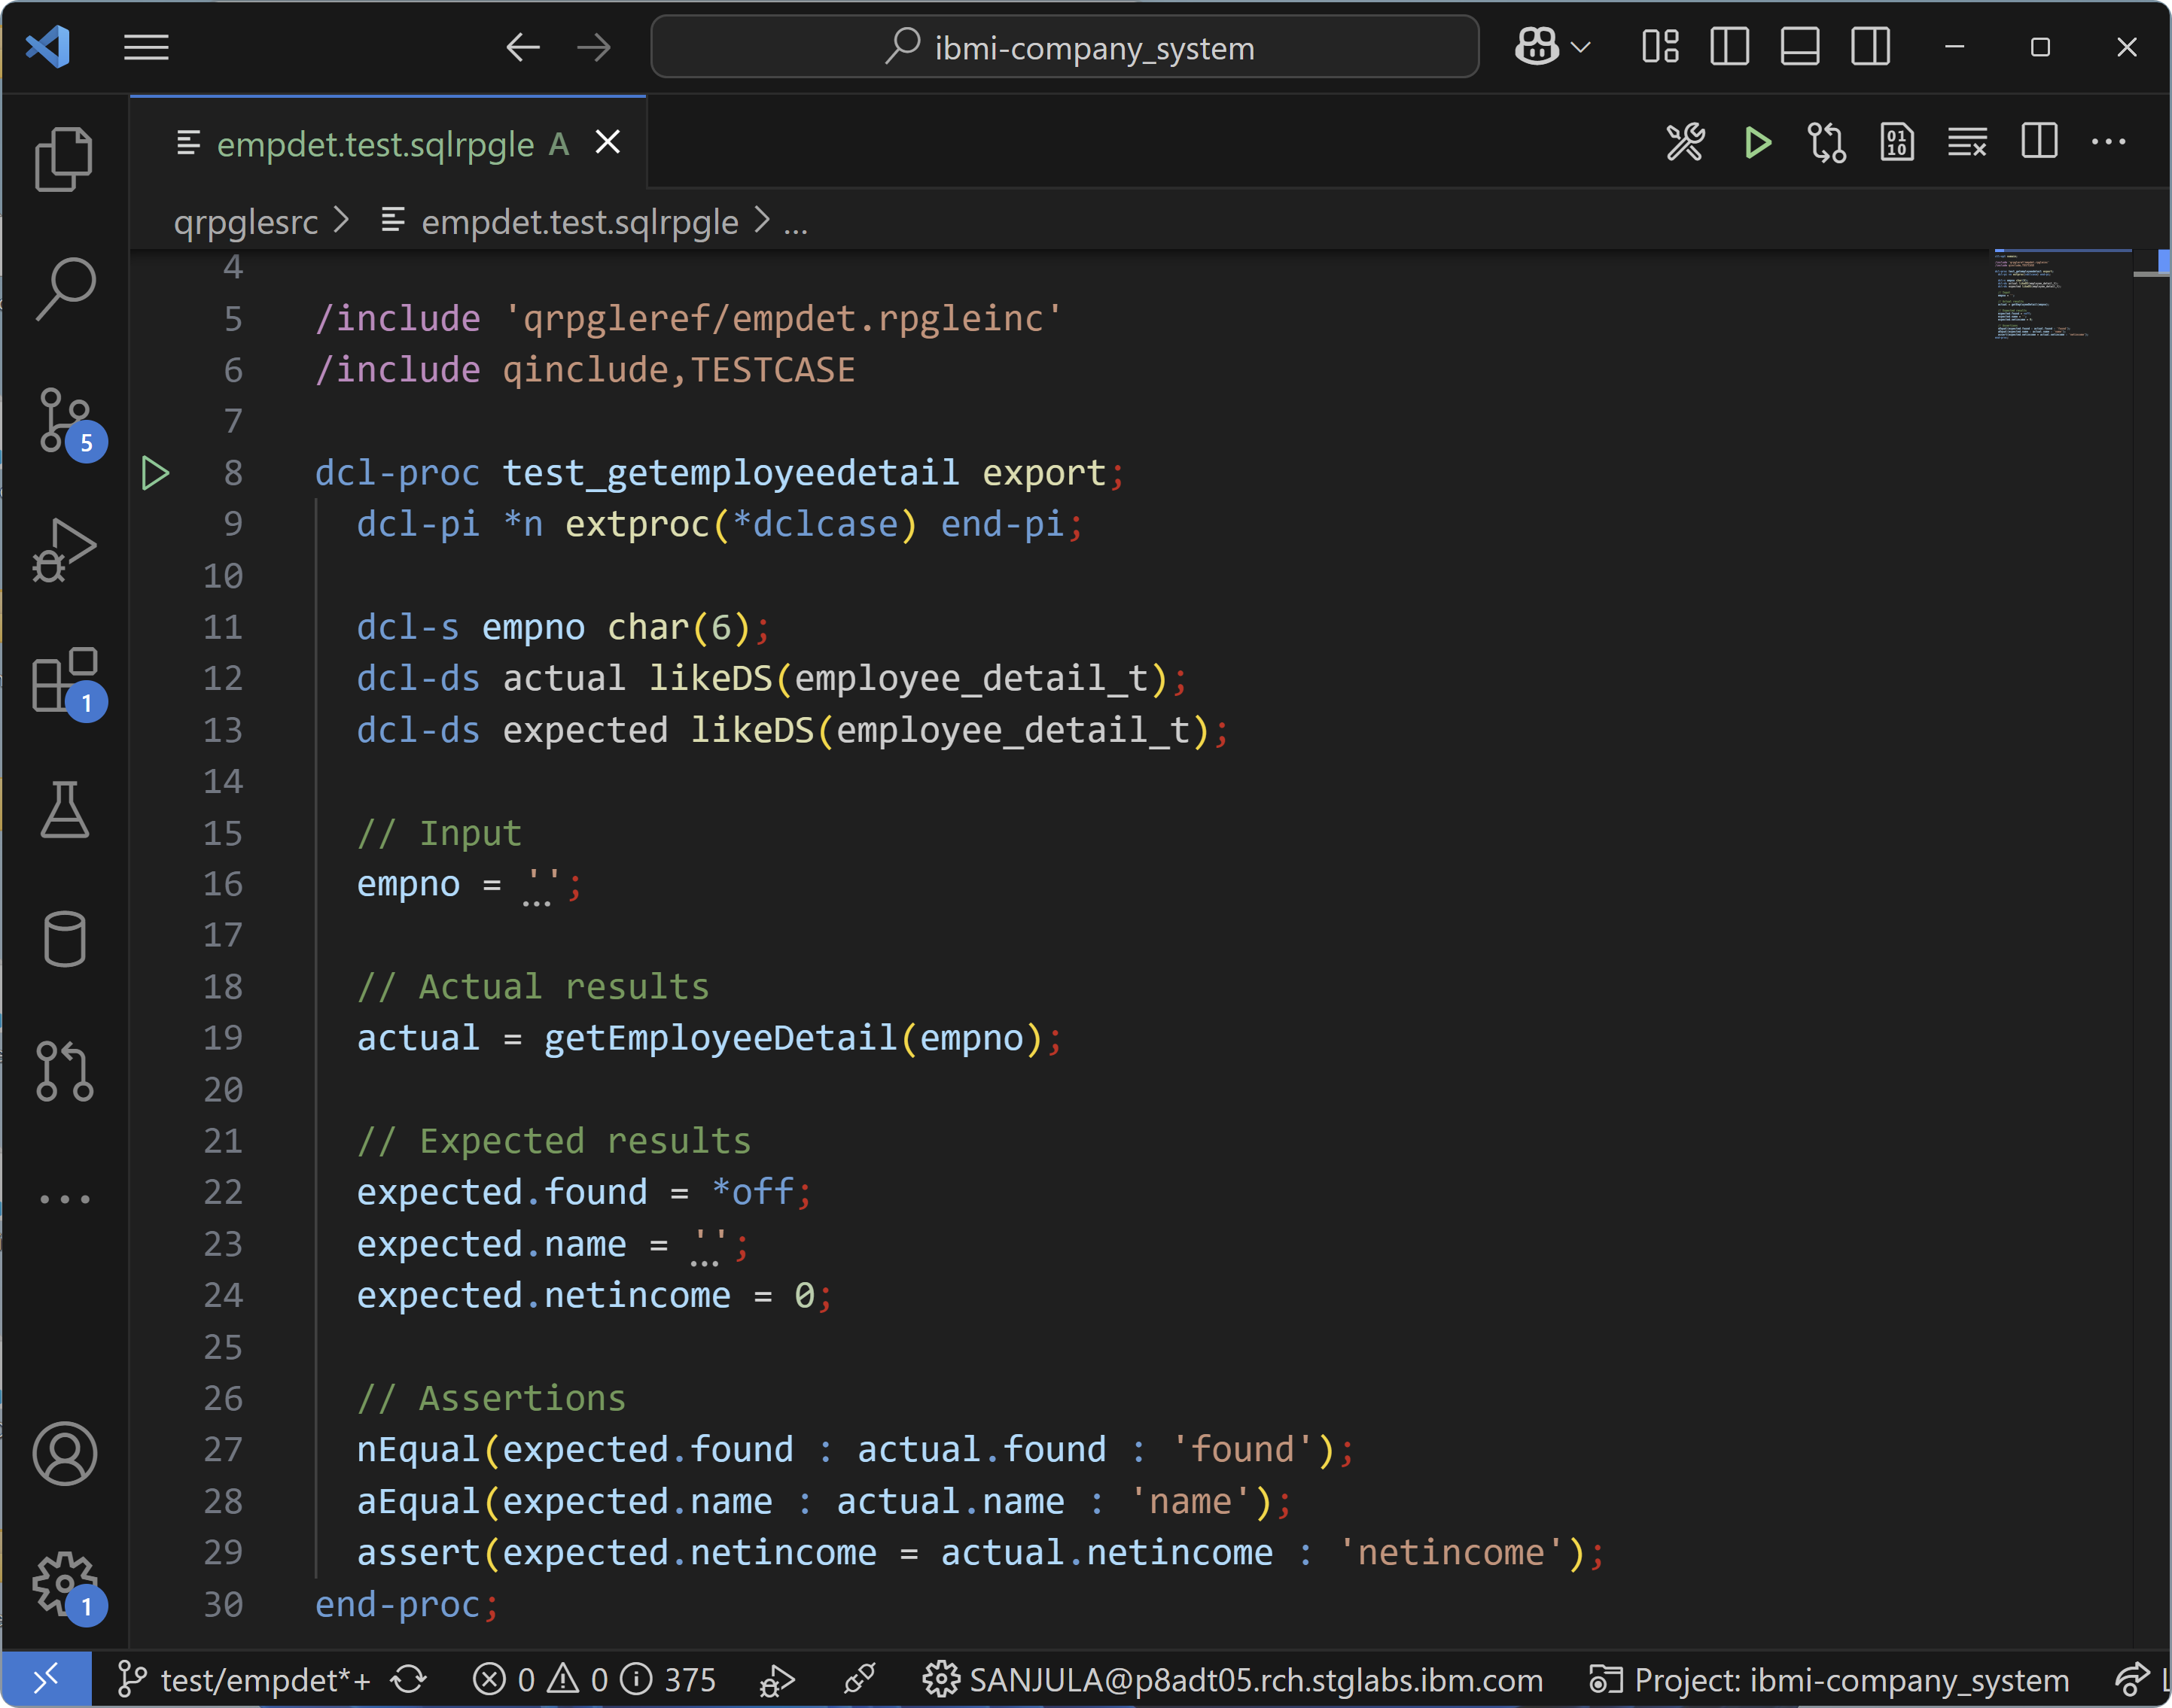
Generating test stubs

Slide 10
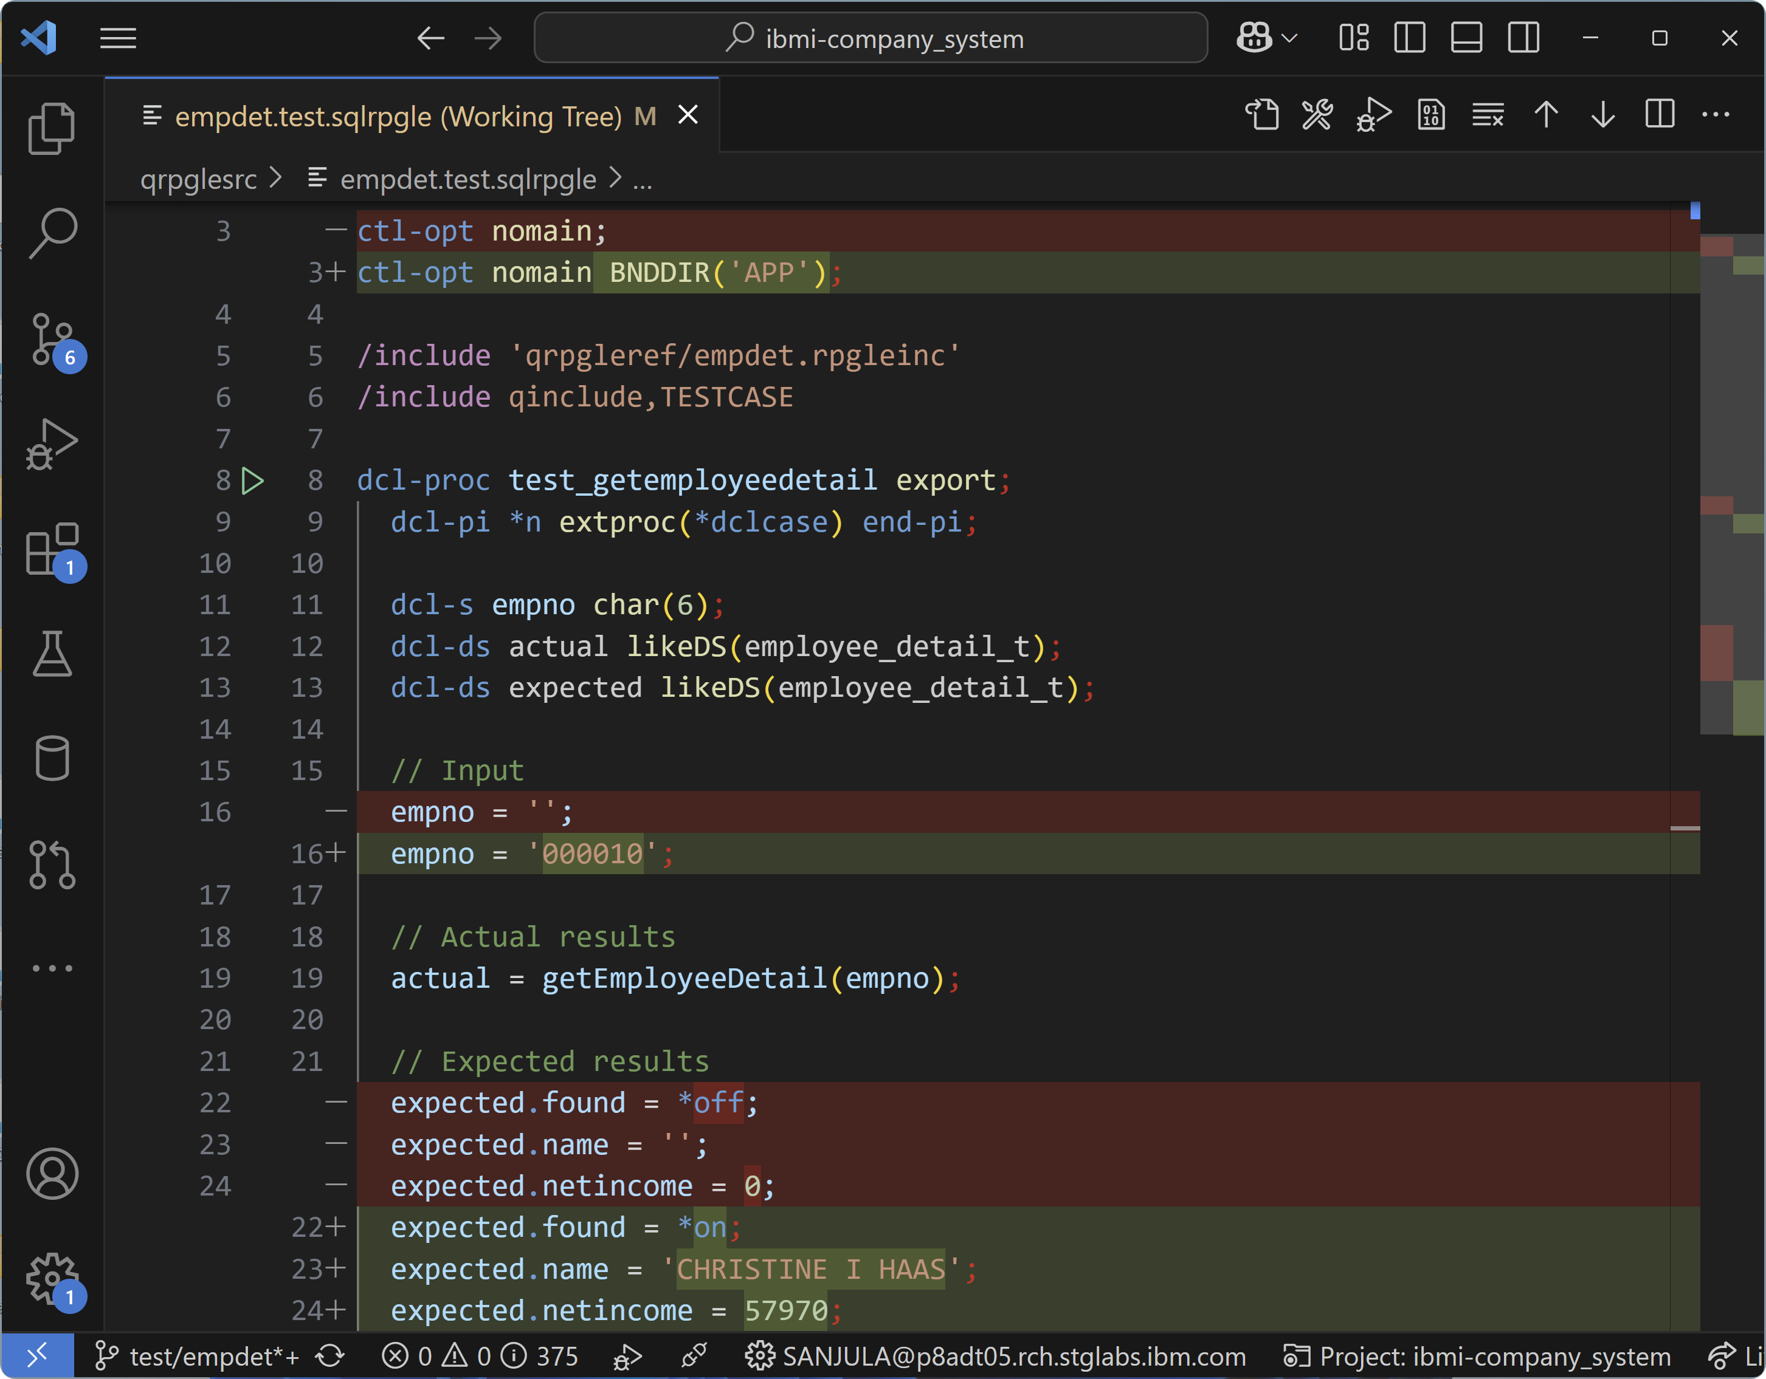
Writing Tests

Slide 11
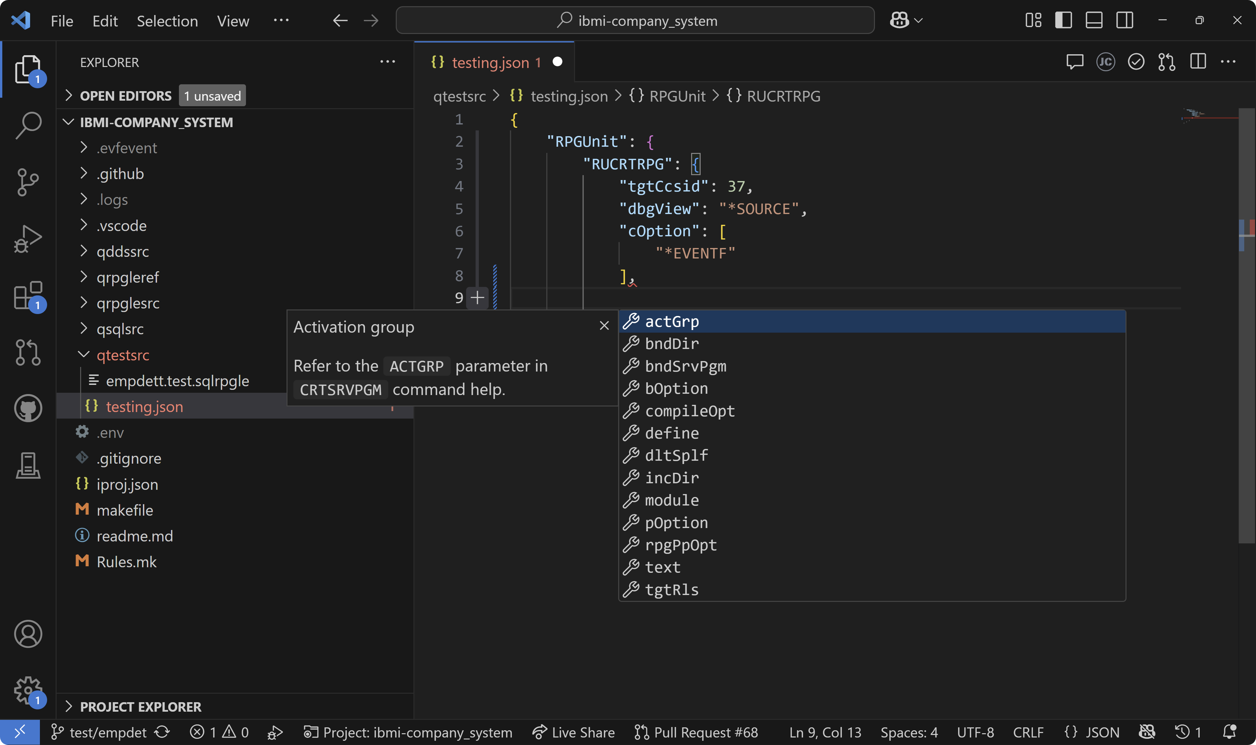
Configuring tests

Slide 12
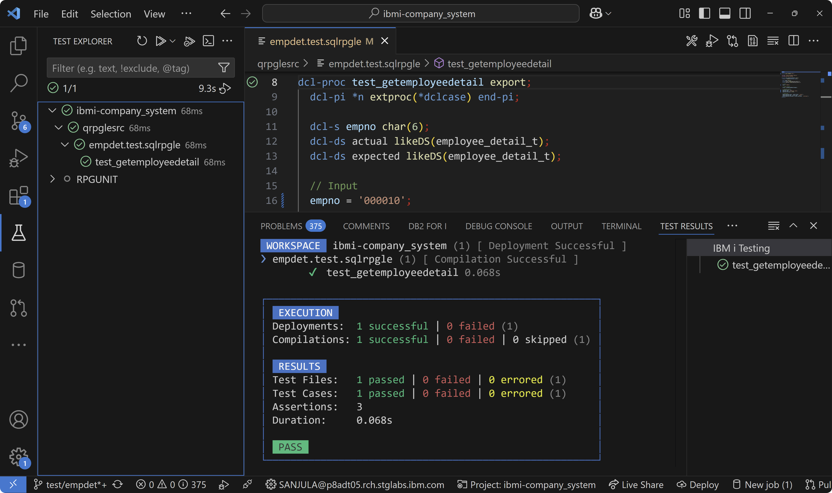
Running unit tests

Slide 13
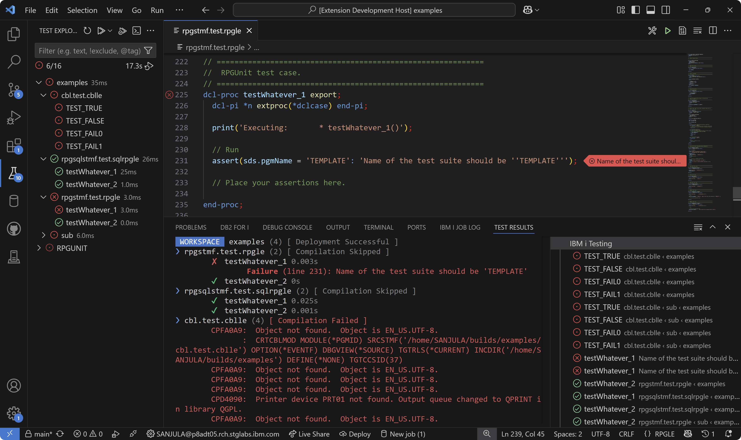
Running tests

Slide 14
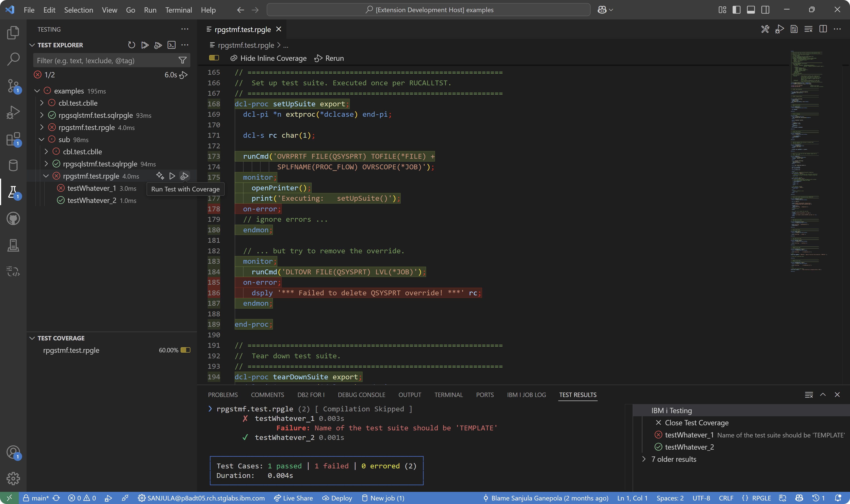
Generating code coverage

Slide 15
Important Links
IBM i Testing
VS Code Marketplace https://marketplace.visualstudio.com/items?itemName=IBM.vscode-ibmi-testing
Documentation https://codefori.github.io/docs/developing/testing/overview/
GitHub Repository https://github.com/IBM/vscode-ibmi-testing
RPGUNIT
Documentation https://irpgunit.sourceforge.io/help/
GitHub Repository https://github.com/tools-400/irpgunit
VS Code
Documentation https://code.visualstudio.com/docs/editor/testing

Slide 16
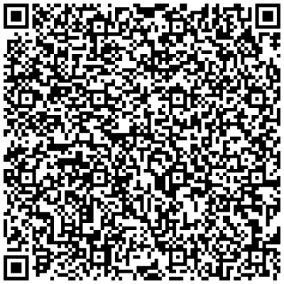
Sanjula Ganepola - IBM i Unit Testing Now in VS Code!
Please take the last minute of this session to complete the evaluation. A direct link to the evaluation can be found using the QR code to the right.

